Slide 1




AI-POWERED
V2V SAFETY
Presented by
Mai Xuan Canh - Ho Chi Minh City University of Technology
1

Slide 2
Home
About
Content
Others
CONTENT
IDEA AND PROBLEM STATEMENT
IMPLEMENTATION OF THE IDEA
EXPECTED OUTCOMES
Utilize AI in V2V to predict and alert dangerous situations, ensuring safer driving.
Develop AI models using data from simulated sensors and traffic software.
Build a smarter, safer, and more efficient traffic ecosystem.
2

Slide 3
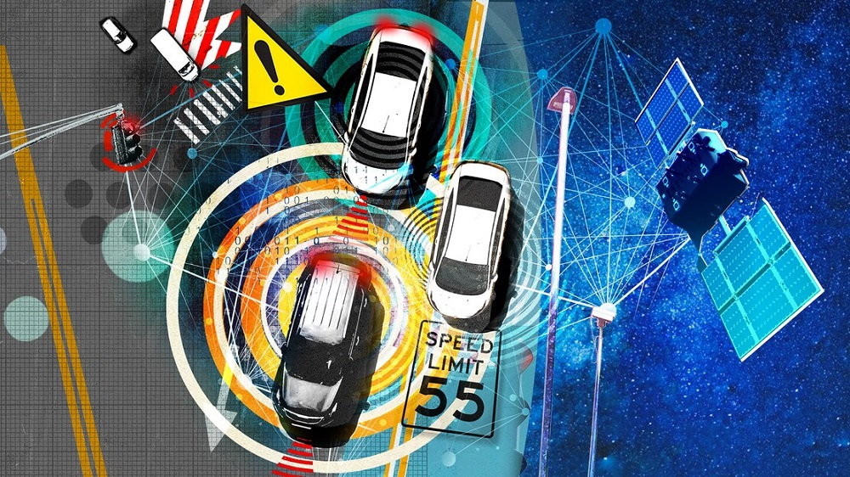
Home
About
Content
Others
IDEA AND PROBLEM STATEMENT
Current traffic systems face major challenges: frequent accidents, congestion, and inefficiencies during emergencies.
According to the WHO, 1.35 million lives are lost each year to road accidents, with 94% caused by human error.
What if technology could predict and prevent such incidents?
3

Slide 4

Home
About
Content
Others
IDEA AND PROBLEM STATEMENT
Data Collection and Integration
Simulation and Testing
AI Model Development
Deployment
AI-Powered
V2V Safety
Notification and Response
Real-Time Monitoring
Feedback and Improvement
Incident Prediction
4

Slide 5
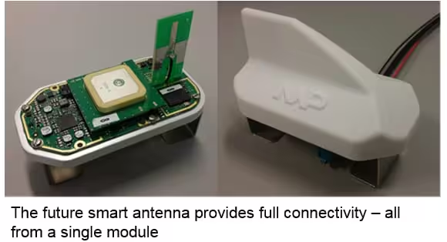
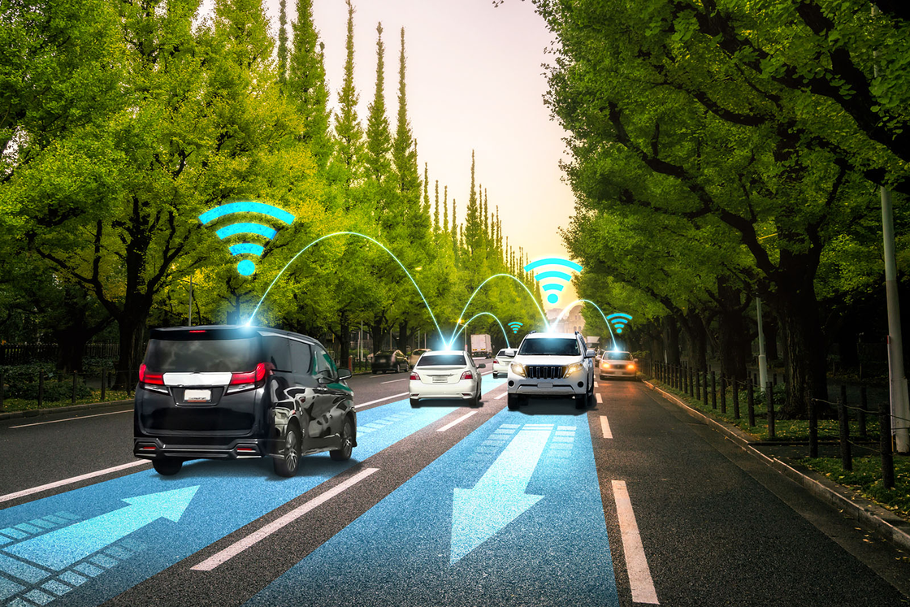
Home
About
Content
Others
HARDWARE
DEVELOPMENT
Sensor Components:
V2V Module
Central Processing Unit
AI chips
Wireless Communication
Integrated Control System
5

Slide 6

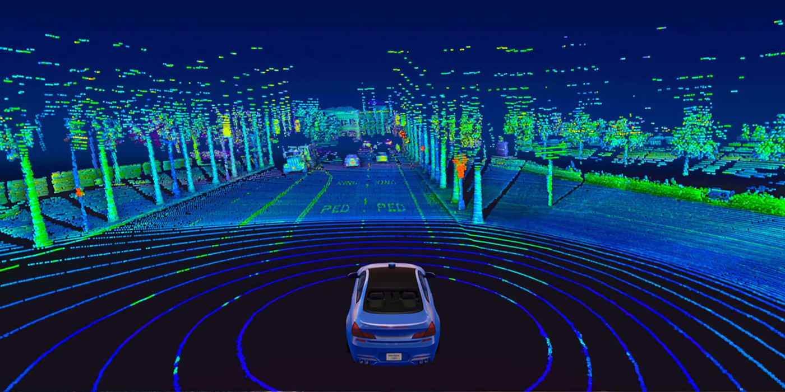
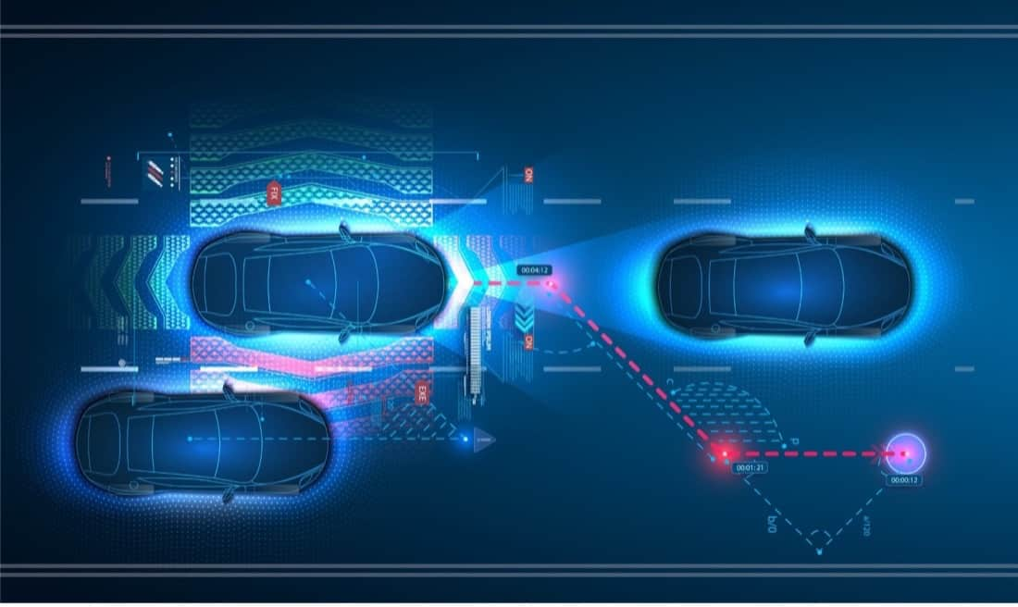
Home
About
Content
Others
HARDWARE DEVELOPMENT
Sensors such as LiDAR, radar, and GPS are employed to continuously gather real-time data.
These devices measure critical parameters like vehicle speed, precise location, and details about the surrounding environment.
This rich dataset forms the backbone of the system, enabling it to respond dynamically to traffic conditions.
6

Slide 7
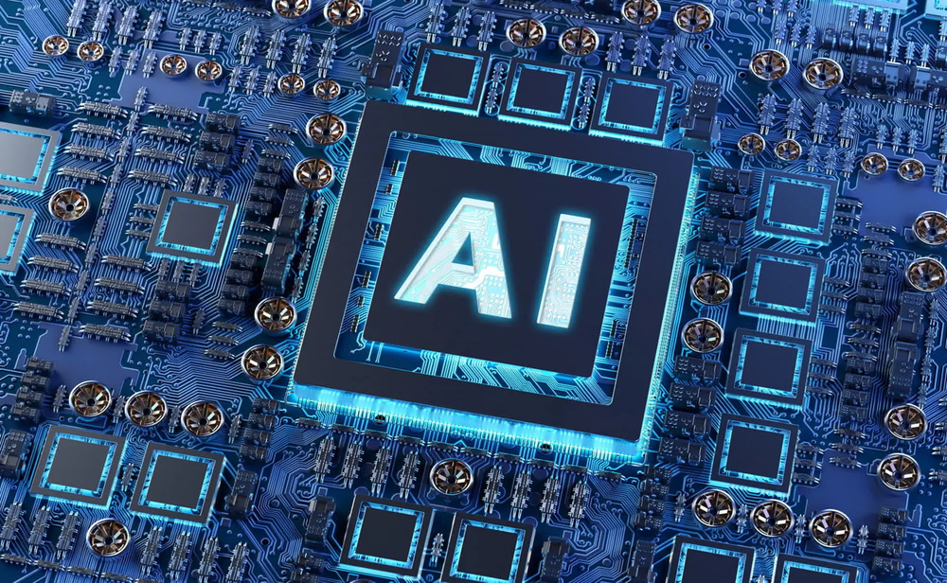
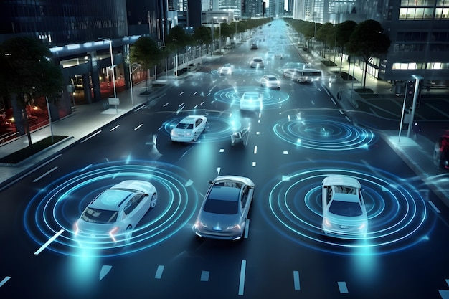
Home
About
Content
Others
HARDWARE DEVELOPMENT
Inside the vehicles, AI chips process this data with remarkable speed.
These chips are designed to handle complex calculations in milliseconds, allowing the system to make rapid decisions that ensure the safety of passengers and pedestrians.
For example, if the sensors detect a potential collision, the AI chip can immediately alert the driver or even activate automated braking systems.
7

Slide 8
Home
About
Content
Others
HARDWARE DEVELOPMENT
Wireless communication technology, specifically Cellular Vehicle-to-Everything (C-V2X), ensures the vehicles are interconnected. This allows seamless data exchange not just between vehicles but also with traffic infrastructure, such as stoplights or road signs.
This level of connectivity is critical for creating a synchronized traffic ecosystem where every element communicates to optimize overall efficiency and safety.
8

Slide 9
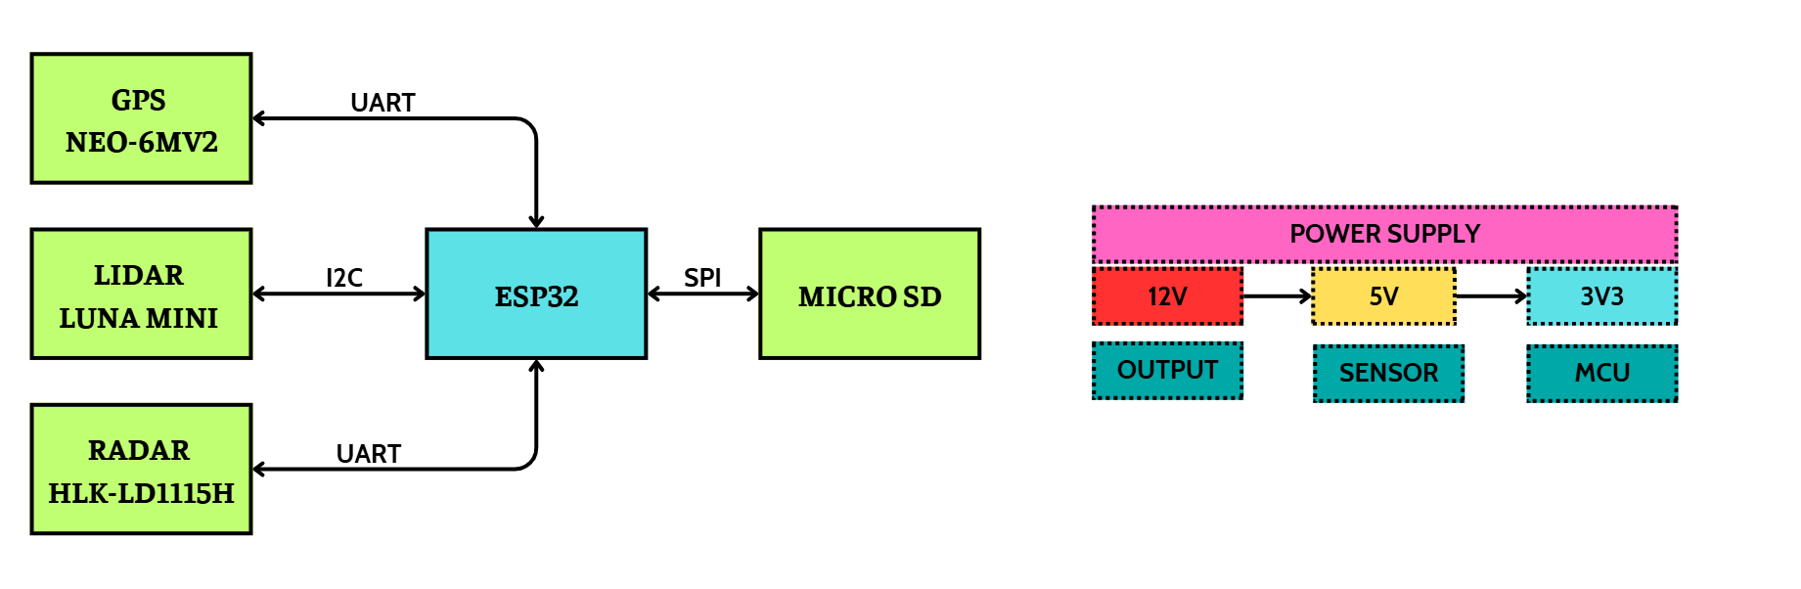
Home
About
Content
Others
HARDWARE BLOCK DIAGRAM
Next, I would like to share about the project I am working on, in which I use the ESP32 microcontroller to collect data from three types of sensors: GPS sensor NEO-6MV2, Lidar sensor TF Luna Mini, and Radar sensor HLK-LD1115H
9

Slide 10
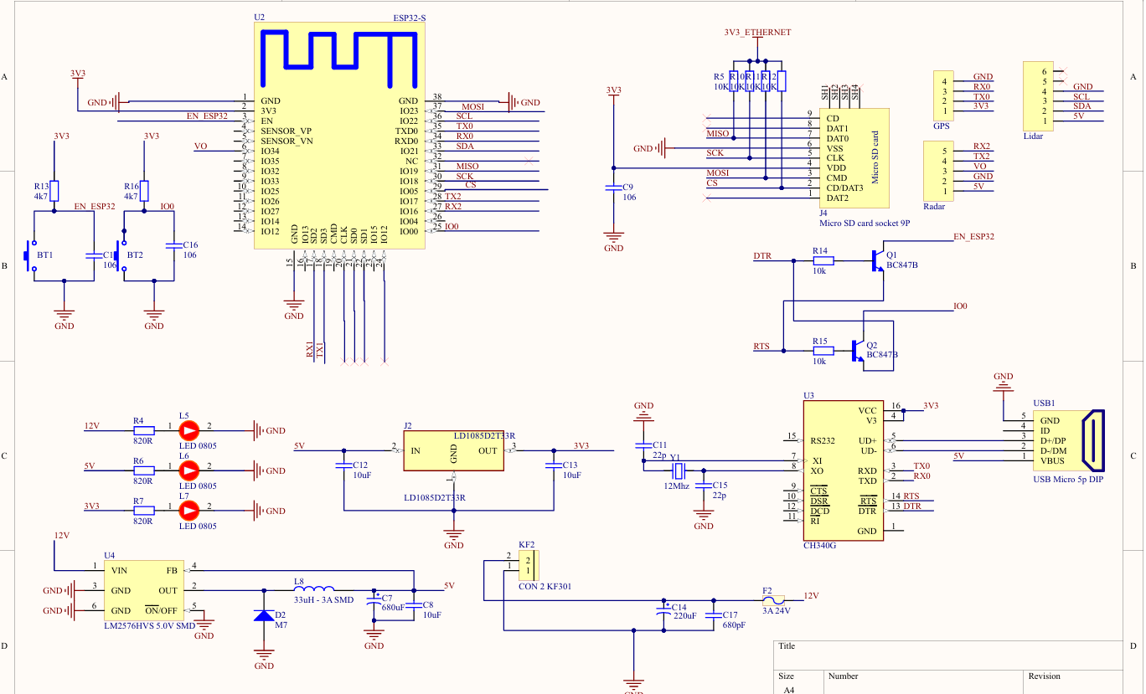
Home
About
Content
Others
HARDWARE SCHEMATIC
10

Slide 11
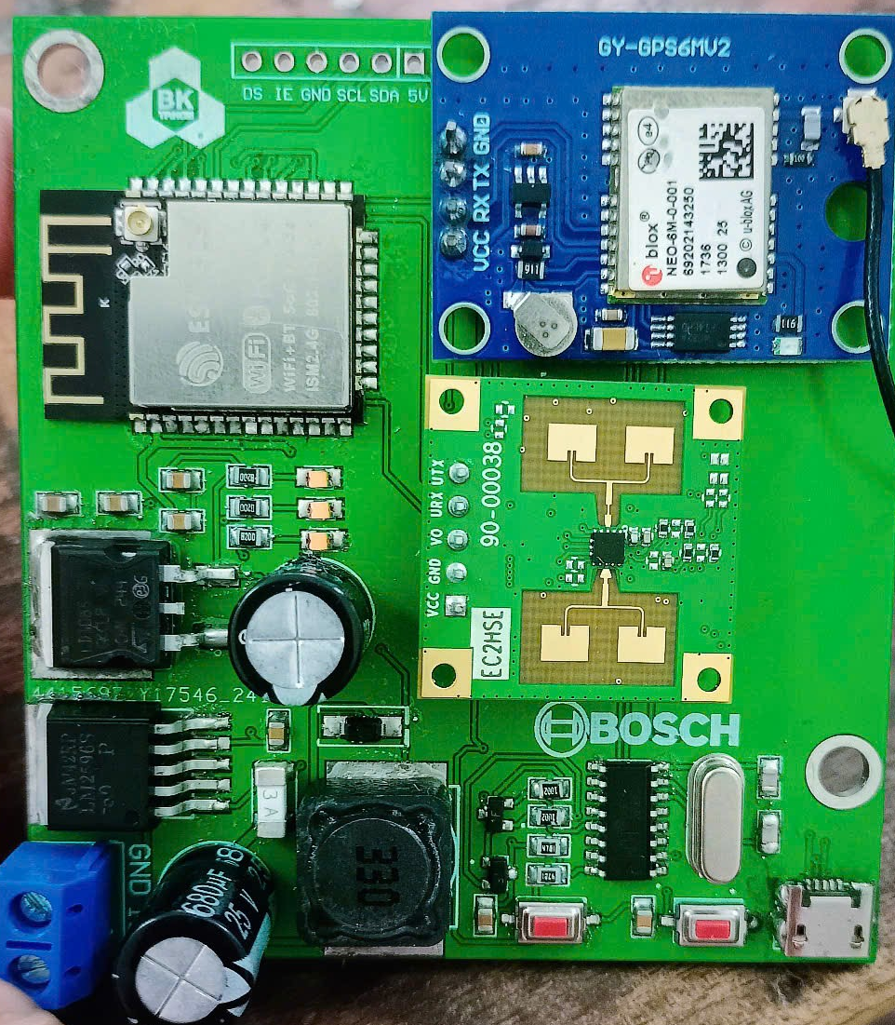
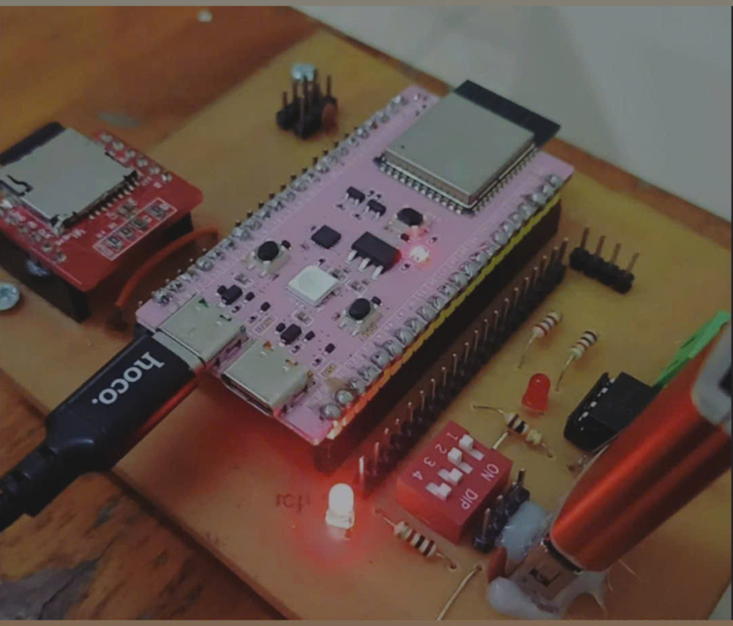
Home
About
Content
Others
HARDWARE PCB
LIDAR MODULE
GPS MODULE
RADAR MODULE
MICRO SD CARD
11

Slide 12

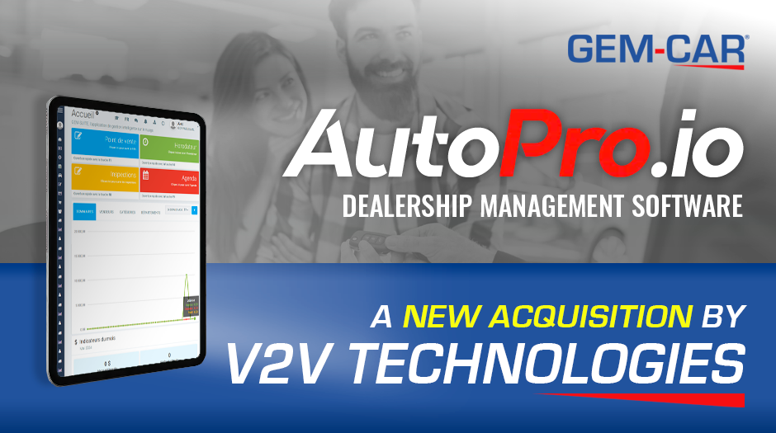
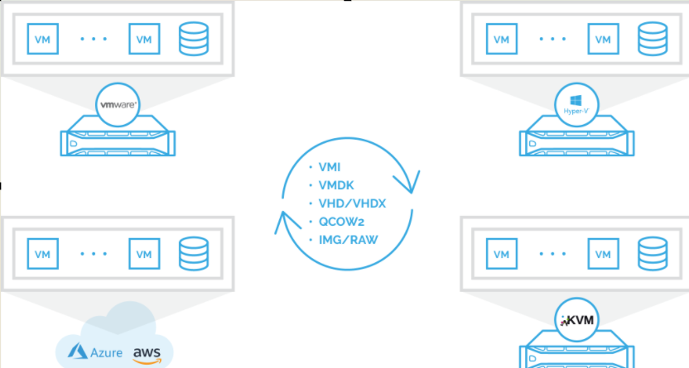
Home
About
Content
Others
SOFTWARE DEVELOPMENT
On the software side, the system leverages advanced machine learning algorithms to interpret the data collected by sensors.
These algorithms are trained to analyze patterns and identify potential risks in real-time.
For example, they can predict situations such as sudden braking by a vehicle ahead or changes in traffic flow due to an obstruction.
12

Slide 13
Home
About
Content
Others
SOFTWARE DEVELOPMENT
To ensure the reliability and robustness of the system, traffic simulation tools like SUMO (Simulation of Urban Mobility) are used extensively.
These tools allow the software to be tested and validated under various real-world conditions.
Simulations help fine-tune the AI algorithms, ensuring that they can handle diverse scenarios, including urban traffic, highway conditions, and adverse weather.
13
8

Slide 14
Home
About
Content
Others
SOFTWARE DEVELOPMENT
The software also includes route optimization capabilities. By analyzing current traffic data and predicting potential delays, it suggests the most efficient routes for drivers, minimizing travel time and fuel consumption.
14
8

Slide 15


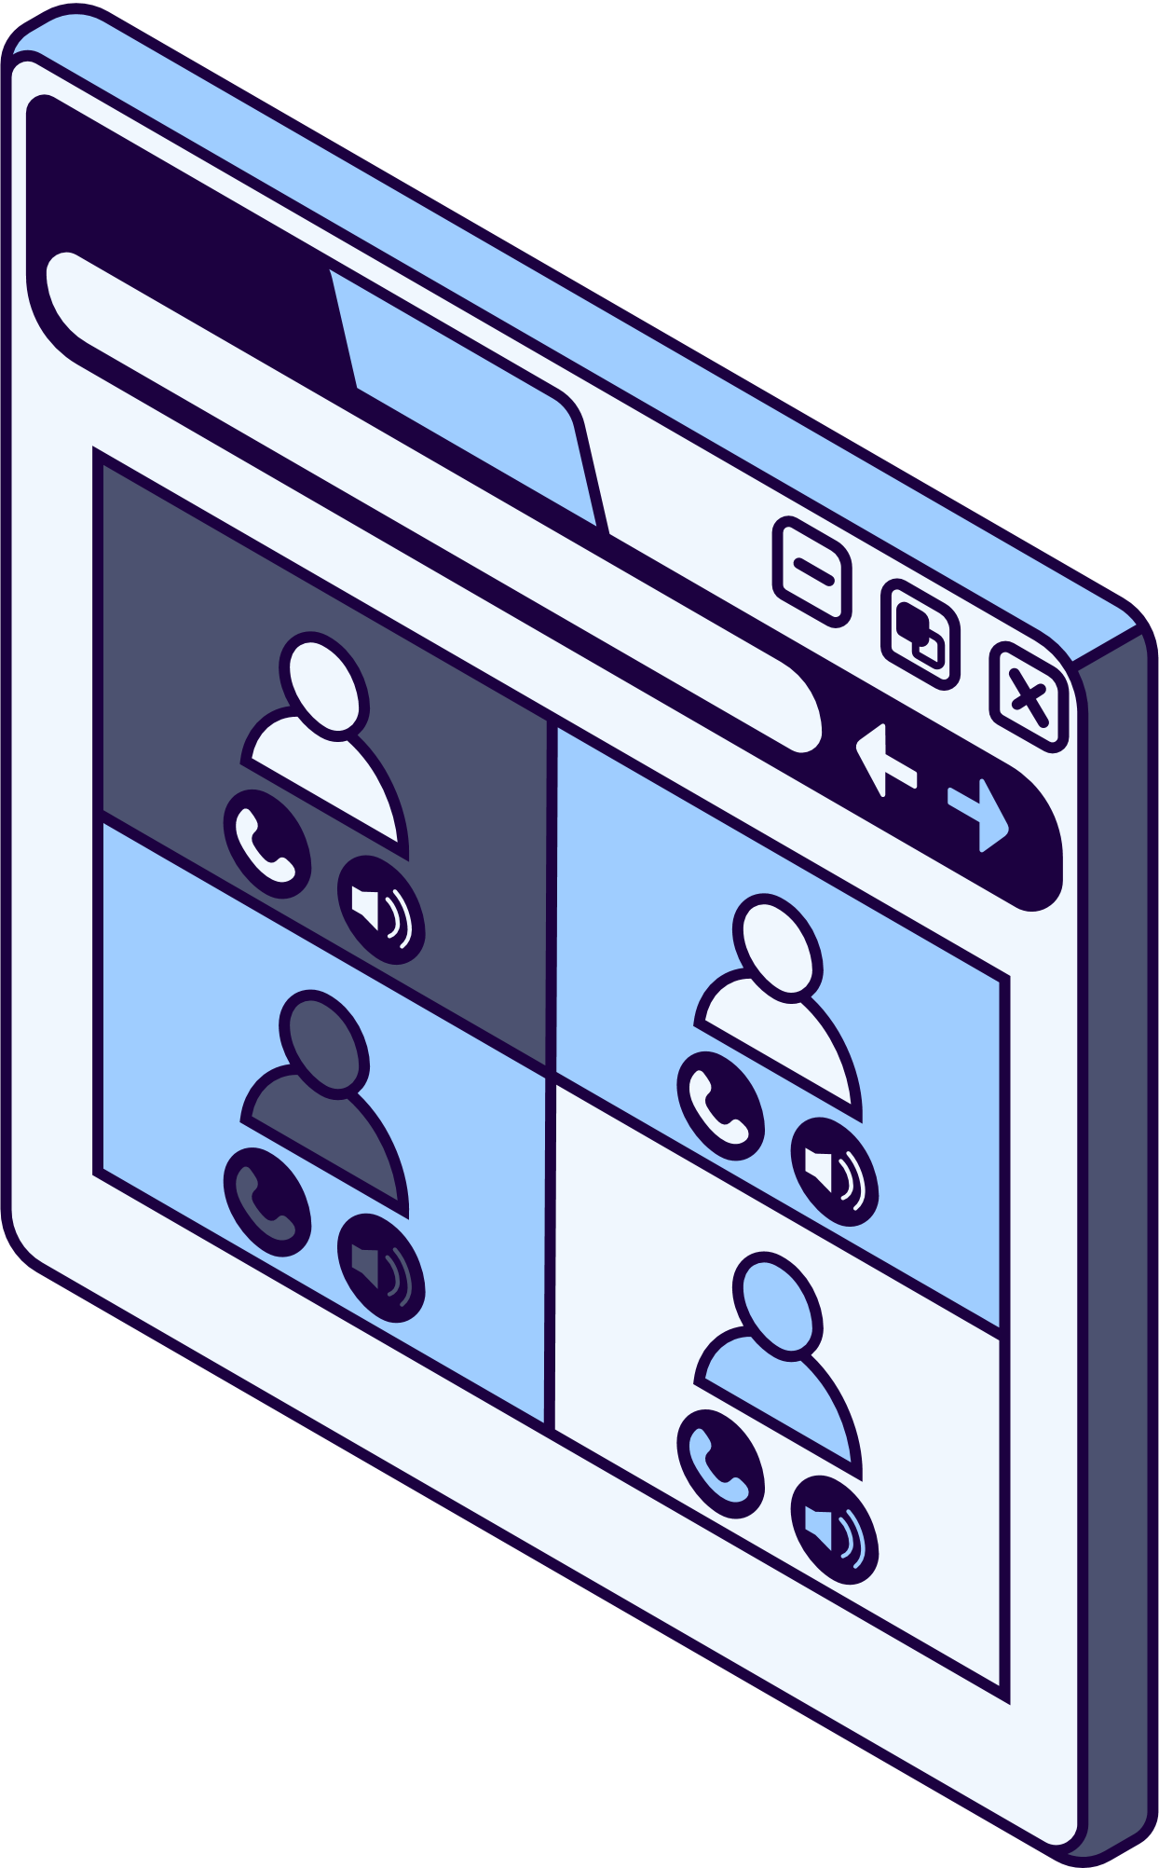



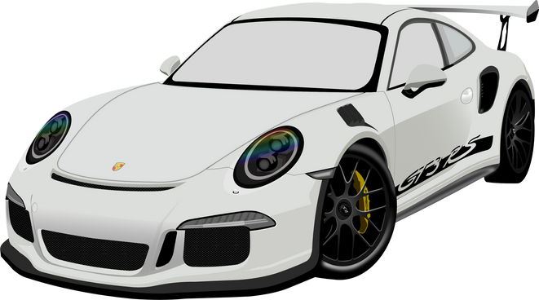

Home
About
Content
Others
SOFTWARE
DEVELOPMENT
Develop AI algorithms to analyze data from sensors and V2V systems in real-time.
Use machine learning to create models for incident prediction, route optimization, and traffic coordination.
Build protocols to send notifications and warnings from the central system to vehicles.
Utilize tools like SUMO or VISSIM to simulate traffic scenarios and test system performance.
15

Slide 16
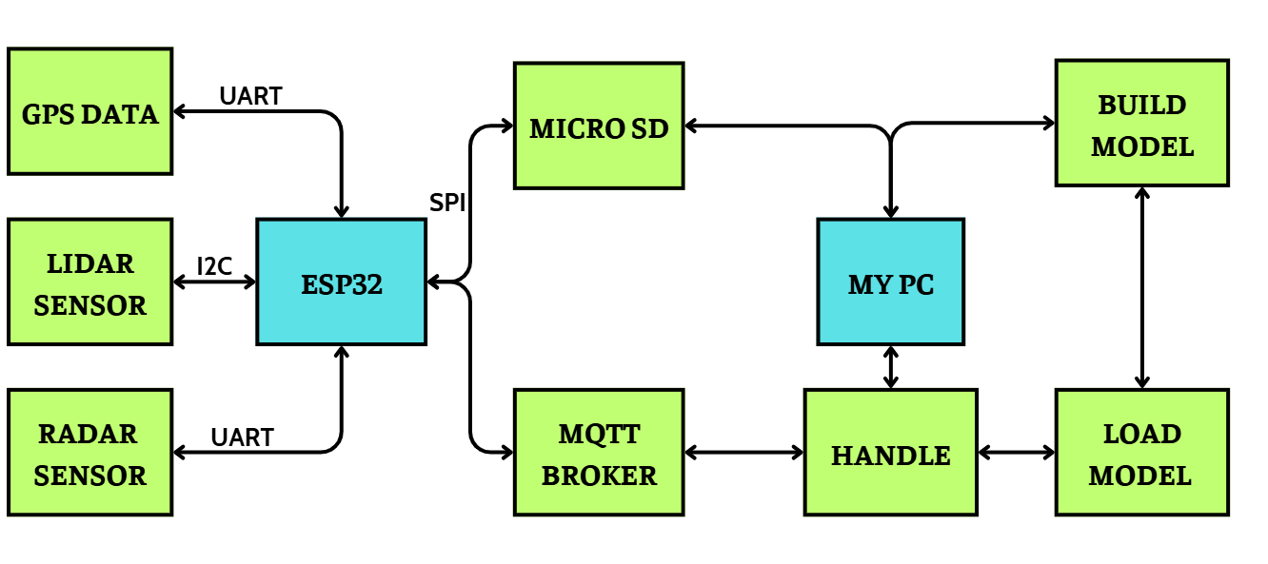
Home
About
Content
Others
SOFTWARE BLOCK DIAGRAM
The data from these sensors is then saved to a memory card as an Excel file. Since I only own one Lidar sensor but need to simulate five cars, I randomly generated data for the remaining four cars to complete the data for the five V2V_N* topic.
16
8

Slide 17
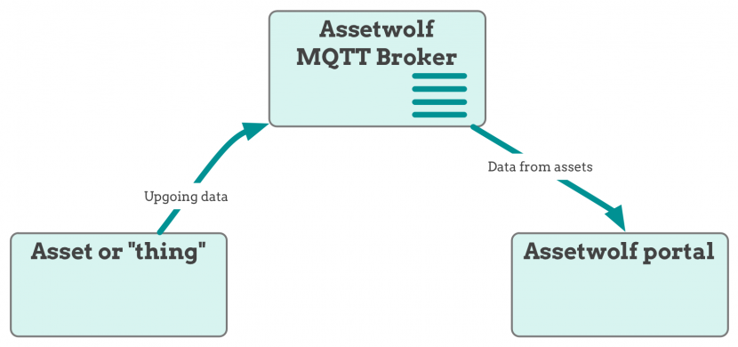
Home
About
Content
Others
SOFTWARE BLOCK DIAGRAM
IP: 3.25.112.140
PUBLIC SERVER
PORT 1883
With the constant movement of vehicles, it is necessary to use a public MQTT broker. I have set up and tested this broker at IP address 3.25.112.140 and port 1883, and everything works fine. This model has been successfully simulated and enables V2V communication, an important step forward in ensuring intelligent traffic safety.
17
8

Slide 18
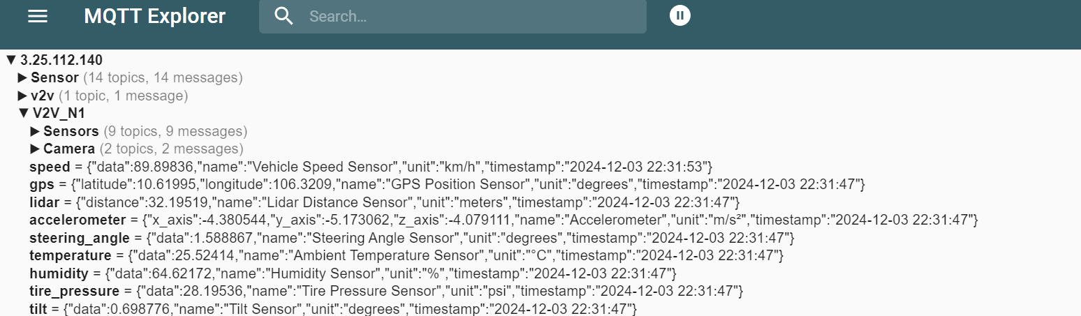
Home
About
Content
Others
SOFTWARE DEVELOPMENT
People can connect to the provided IP address to follow and better understand how the V2V simulation system I built works.
18
8

Slide 19
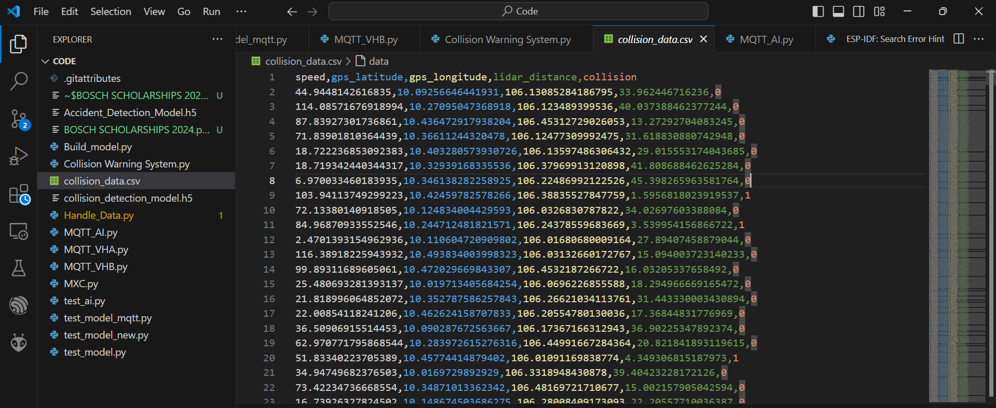
Home
About
Content
Others
SOFTWARE DEVELOPMENT
19
8

Slide 20
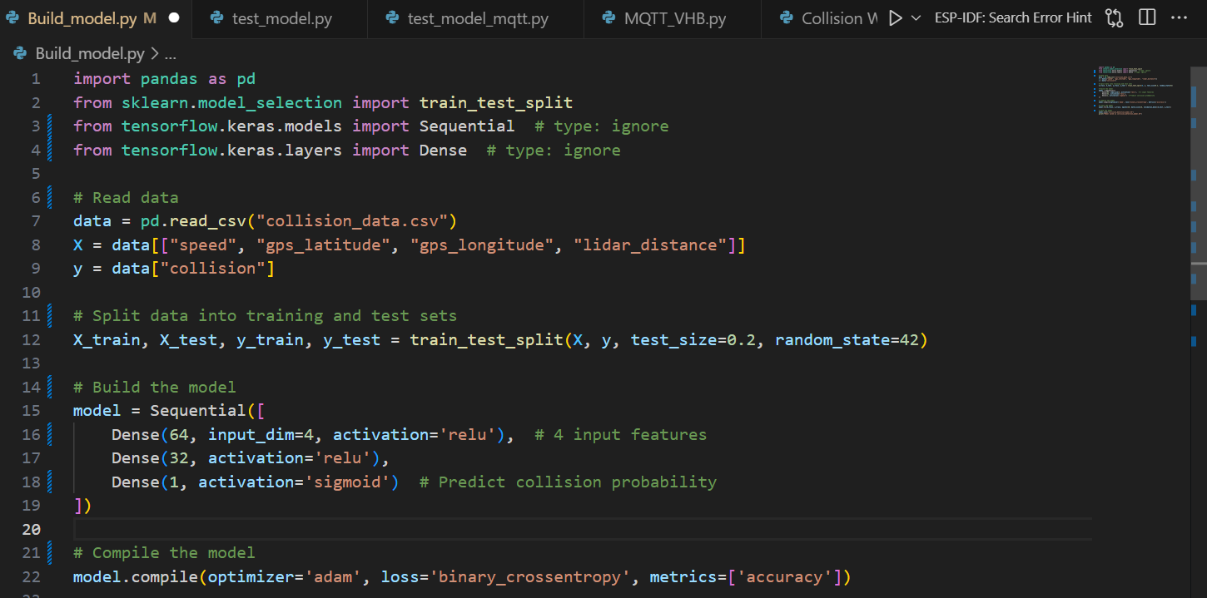
Home
About
Content
Others
CREATE MODEL COLLISION_DETECTION
All this data is sent as JSON to my personal computer, which acts as a server for collection and processing. I built an AI model called collision_detection_model.h5 using the tensorflow.keras.models library to process this data.
20

Slide 21
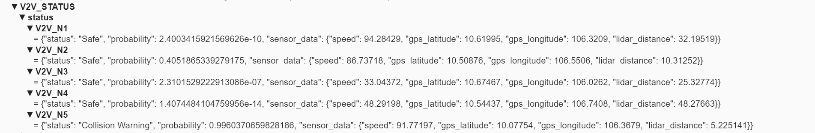
Home
About
Content
Others
RESULTS
The model is designed to determine whether the condition is safe or dangerous based on the data from three sensors and then send the processing results back to the MQTT broker with the topic V2V_STATUS.
In the future we use 4g/5g with high speed wireless communication and support integrated gps through modules such as QUECTEL EC25 and SIM7600G-H to be more practical instead of wifi.
21

Slide 22


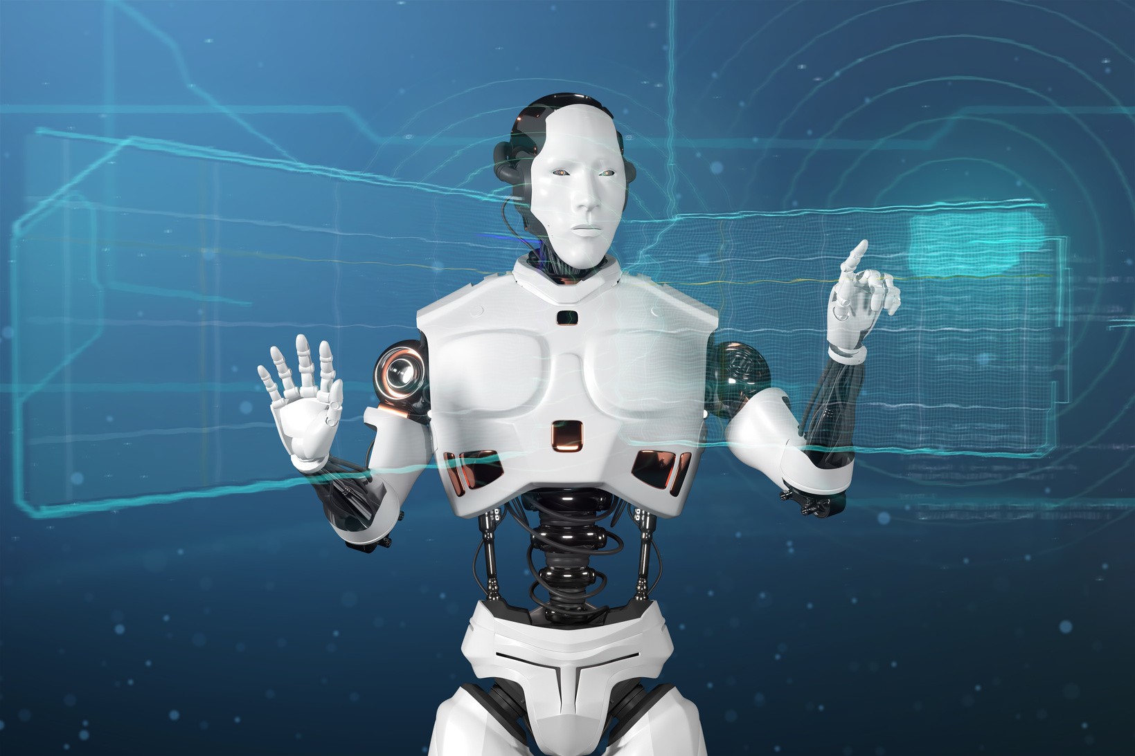

INNOVATIONS
What sets this project apart is its innovative integration of AI into the V2V system. Traditional V2V systems typically rely on pre-defined protocols for data sharing and decision-making. However, by embedding AI, this system gains the ability to predict incidents proactively, automate critical decisions, and continuously learn from new data.
22
8

Slide 23
INNOVATIONS
For example, as more vehicles equipped with this system enter the network, the AI becomes more intelligent through shared experiences, improving its accuracy and adaptability over time. This self-learning capability ensures that the system remains effective as traffic conditions evolve, providing long-term value and scalability.
23

Slide 24
INNOVATIONS
By combining cutting-edge hardware, intelligent software, and innovative approaches, this project not only addresses existing traffic issues but also lays the foundation for a future where transportation is safer, more efficient, and deeply interconnected.
24

Slide 25


Home
About
Content
Others
DEVELOPMENT PATH
FROM V2V TO V2X
1
2
3
4
Vehicle-to-Infrastructure
Vehicle-to-Pedestrian
Vehicle-to-Network
Vehicle-to-Grid
Communication with traffic lights, road sensors, and digital signage
Connecting with pedestrians' mobile devices to enhance safety in urban areas
Accessing real-time data such as weather, traffic conditions, and infotainment services
Interaction with the power grid to optimize energy usage and support electric vehicles
25

Slide 26


EXPECTED OUTCOMES
The expected outcomes of the AI-Powered V2V Safety project are both impactful and transformative, addressing some of the most pressing issues in traffic systems today.
First and foremost, the system aims to improve safety on the roads. By utilizing AI to predict potential accidents and sending early warnings to drivers, the project has the potential to reduce road accidents by up to 30%. This translates to fewer injuries, fewer fatalities, and a safer environment for all road users.
26

Slide 27
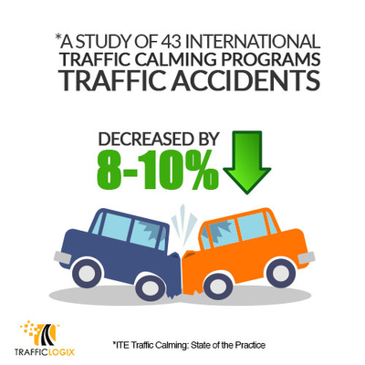
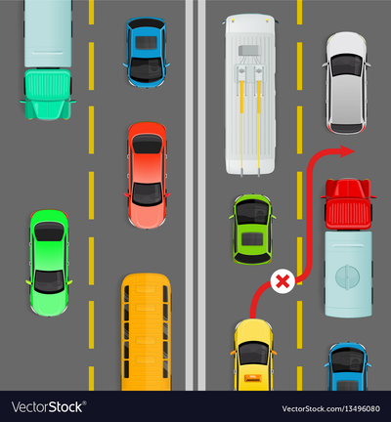
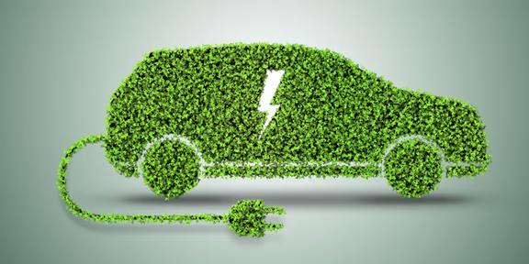
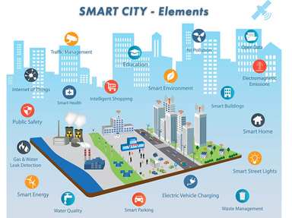
Home
About
Content
Others
AI-POWERED V2V Safety
EXPECTED OUTCOMES
Availability
Performance
Management
Future
Reduced Traffic Accidents
Optimized
Traffic Flow
Smart City Integration
Energy Savings
[SHORT TERM]
[LONG TERM]
27

Slide 28
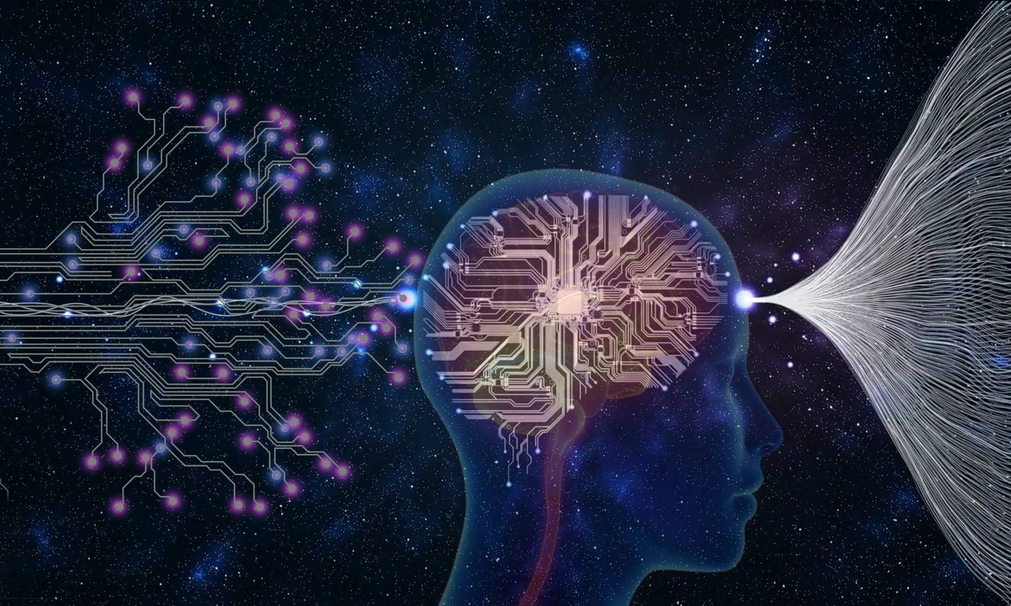
EXPECTED OUTCOMES
Another significant outcome is energy savings. With the system's ability to optimize routes based on real-time traffic data, vehicles can avoid unnecessary stops, detours, or delays. This leads to reduced fuel consumption and lower greenhouse gas emissions, supporting both economic and environmental sustainability.
16

Slide 29
EXPECTED OUTCOMES
Finally, the system paves the way for smart city integration. By connecting vehicles, traffic infrastructure, and urban management systems, this project contributes to building a fully integrated traffic ecosystem. Such a system can adapt to the needs of rapidly growing urban areas, ensuring that cities remain livable and efficient as they expand.
17

Slide 30
Home
About
Content
Others
SECURITY AND SAFETY
Data Security: Encrypt data to prevent unauthorized access and cyberattacks.
Threat Detection: Use AI to identify and neutralize abnormal behaviors
System Safety: Ensure stable and reliable operations under emergency conditions
28

Slide 31

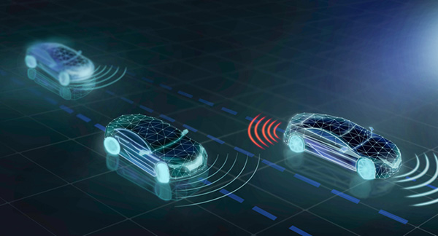
Home
About
Content
Others
FINANCIAL ASPECTS
IMPLEMENTING AI V2V
High setup costs for V2V hardware and AI integration
Reduced accident-related expenses and property damage
Economic Efficiency, Improved traffic flow reduces delays and energy waste
29

Slide 32
Home
About
Content
Others
AI V2V APPLICATION DIRECTIONS
AT BOSCH
Integration into Intelligent Vehicle Management Systems
Development for Autonomous Vehicles
Energy-Efficient Solutions
Collaboration with Smart Cities
22

Slide 33
Home
About
Content
Others
POTENTIAL GROWTH
AI-POWERED V2V Safety
1.
Potential Growth Areas
2.
Practical Applications
Intelligent Transportation Systems (ITS)
High-level Autonomous Vehicles (Level 4, 5)
Smart Cities
Europe and the US
Asia (Vietnam, China, Japan,...)
3.
Development Directions
4.
Long-term Goals
Advancing Network Technology
Integrating Artificial Intelligence
Public-Private Collaboration
Skilled Workforce Preparation
Establish a fully integrated transportation ecosystem where all elements in the traffic environment communicate and interact seamlessly.
21

Slide 34
Home
About
Content
Others
APPLICATION AT BOSCH
The innovations from this project align perfectly with Bosch’s expertise and long-term goals, making it highly applicable to various Bosch initiatives.
One of the primary applications is the integration into Advanced Driver Assistance Systems (ADAS). By enhancing ADAS with AI-driven V2V communication, Bosch can improve intelligent vehicle management, enabling vehicles to respond to their environment more effectively.
30
8

Slide 35


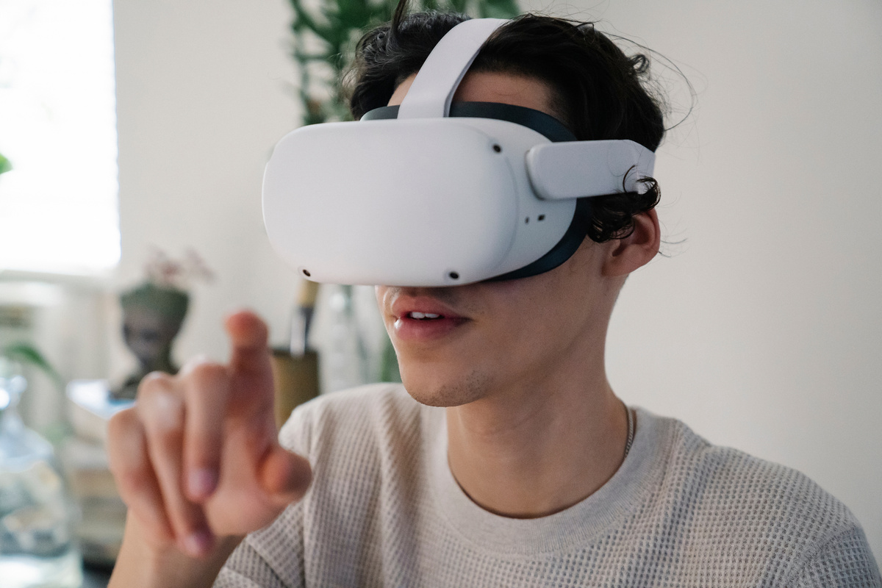
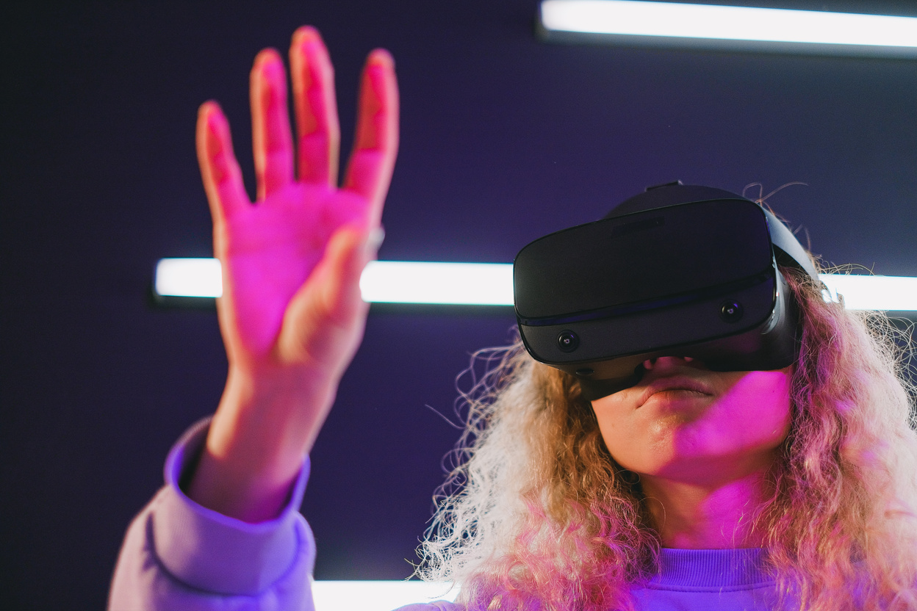
APPLICATION AT BOSCH
The system also supports the development of autonomous vehicles, a key area of focus for Bosch. With its advanced capabilities in obstacle detection and route optimization, the project provides critical tools for ensuring the reliability and safety of autonomous vehicles in complex traffic scenarios.
Furthermore, the project contributes to energy-efficient solutions, helping Bosch achieve its sustainability objectives. By reducing fuel consumption and emissions, the system aligns with Bosch’s commitment to environmental responsibility.
31
8

Slide 36


Presented by
Mai Xuan Canh - Ho Chi Minh City University of Technology
THANK
YOU!
Thank you for the wonderful opportunity that the Activator Scholarship 2024 at Bosch offers.
I am extremely grateful for your support and belief in my potential to contribute to innovation and challenge.

